Slide 1
Densify Point Clouds: Sprint 2
By Group A2_9: Brian, Chris, and Risa

Slide 2
Our Redefined MVP and user story
(Old MVP): Pick a part in the photogrammetry pipeline and optimize it
New MVP: Densify the point cloud that could be fed to an AI or user
User: any company that uses point clouds in open source
As a company I would like to densify the point cloud that could be into our open source software

Slide 3
Sprint 2 Tasks
First research papers that are currently doing work
Understand the research and figure out what modules and software the authors use
Realize feasibility of integrating their methods into our pipeline
Set up the development software
Install Pytorch 3D and PCL
See if it's possible to install packaged on the cloud to make an easier working environment
Test software

Slide 4
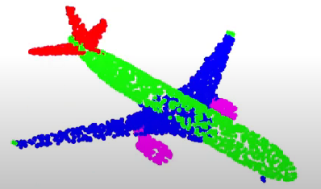
Achievements
We found a website that list papers to do with the reconstruction of point clouds that are most reproducible. In doing so we found a paper involving a framework called Torch-Points3D. Its a “modular multi-task framework for reproducible deep learning on 3D point clouds”
We successfully installed torch-3d onto the SCC using virtualenv and tested a simple example

Slide 5
Our Failures
We weren't able to install torch-3d on our local systems although we did have success in running the framework on collabs
We didn't have time to test the PCL library
We have yet to research a paper with a strict set of instructions in creating a deep learning algorithm for the reconstruction of point clouds so research will continue into sprint 3

Slide 6
Sprint 3 Tasks
Continue research on papers and start to reproduce results of the research paper we found
Test advanced tutorials on pytorch 3d
Start mapping out our pipeline that involves integrating a ML module in pytorch 3d
(Reach goal) Install and play around with open 3d and see if the framework is more user friendly

Slide 7
Work Cited
Torch-3d paper
https://ieeexplore.ieee.org/abstract/document/9320410

